Slide 1
International Islamic University Chittagong
Course Code: CSE-3634
Course Title: Computer Networking Sessional
Submitted to:
Abdullahil Kafi
Assistant Professor, Dept. of CSE

Slide 2
Final Project
Project Title: Enhancing Fault Tolerance and Network Efficiency through Advanced HSRP and OSPF Integration
Team Redundancy
C211005 | Afif Hossain Irfan (Leader)
C211007 | Farhan Faiyaz Tahsin
C211024 | Arif Rahman Sikder
C211032 | Rashedul Arefin Ifty
C211035 | MD. Ismail

Slide 3
Introduction:
For redundancy and dynamic routing, this project entails setting up a network in GNS3 utilizing the Hot Standby Router Protocol (HSRP) and Open Shortest Path First (OSPF). The objective is to guarantee optimal availability and effective routing, enabling smooth failover in the event of a router malfunction. Three routers are part of the network configuration: R1 and R2 utilize HSRP to back each other up, and R3 connects to an external network and employs OSPF for dynamic routing. This setup guarantees the network's stability and operation.

Slide 4
Motivation:
Empower networks with seamless redundancy and optimal efficiency. By integrating Hot Standby Router Protocol (HSRP) and Open Shortest Path First (OSPF), our project ensures uninterrupted connectivity, dynamic failover, and intelligent routing. Elevate network reliability, resilience, and performance for a robust and responsive infrastructure.

Slide 5
HSRP and OSPF: Elevating Network Reliability and Efficiency
Overview:
Always Connected: HSRP is like a backup hero, making sure our internet stays on.
Smart Travel: OSPF acts like a clever GPS, finding the fastest way for our internet data.
Objective:
Make our internet better by teaming up HSRP and OSPF for a more reliable and faster experience.

Slide 6
Hot Standby Router Protocol (HSRP)
When we access websites or send emails, our requests are directed through routers, which act as traffic controllers for data. HSRP functions as a backup system for these routers. If one router encounters an issue, HSRP quickly switches the traffic to a standby router, ensuring continuous data flow without interruption. It's essentially a safety net for maintaining our internet connection.

Slide 7
Open Shortest Path First (OSPF)
Imagine a city map with multiple routes to a destination. OSPF operates like an advanced GPS system for data, determining the quickest and most efficient path for information to travel. If a particular route becomes congested or encounters a problem, OSPF dynamically finds an alternative path, ensuring data reaches its destination promptly and efficiently.

Slide 8
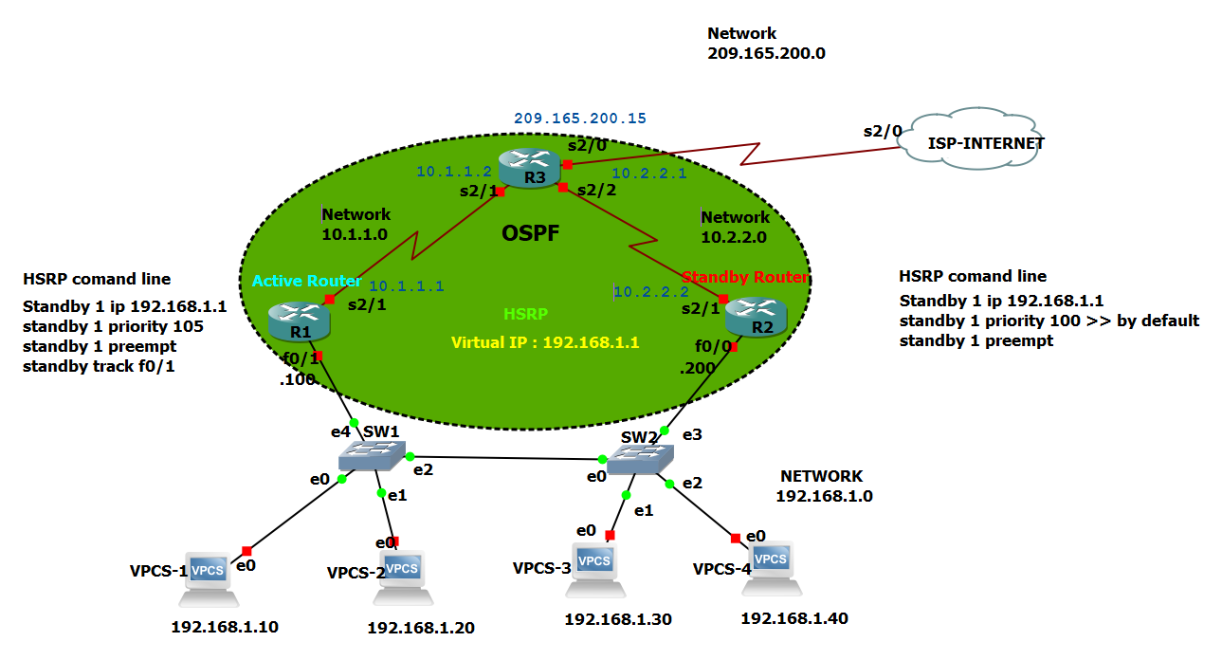
topology

Slide 9
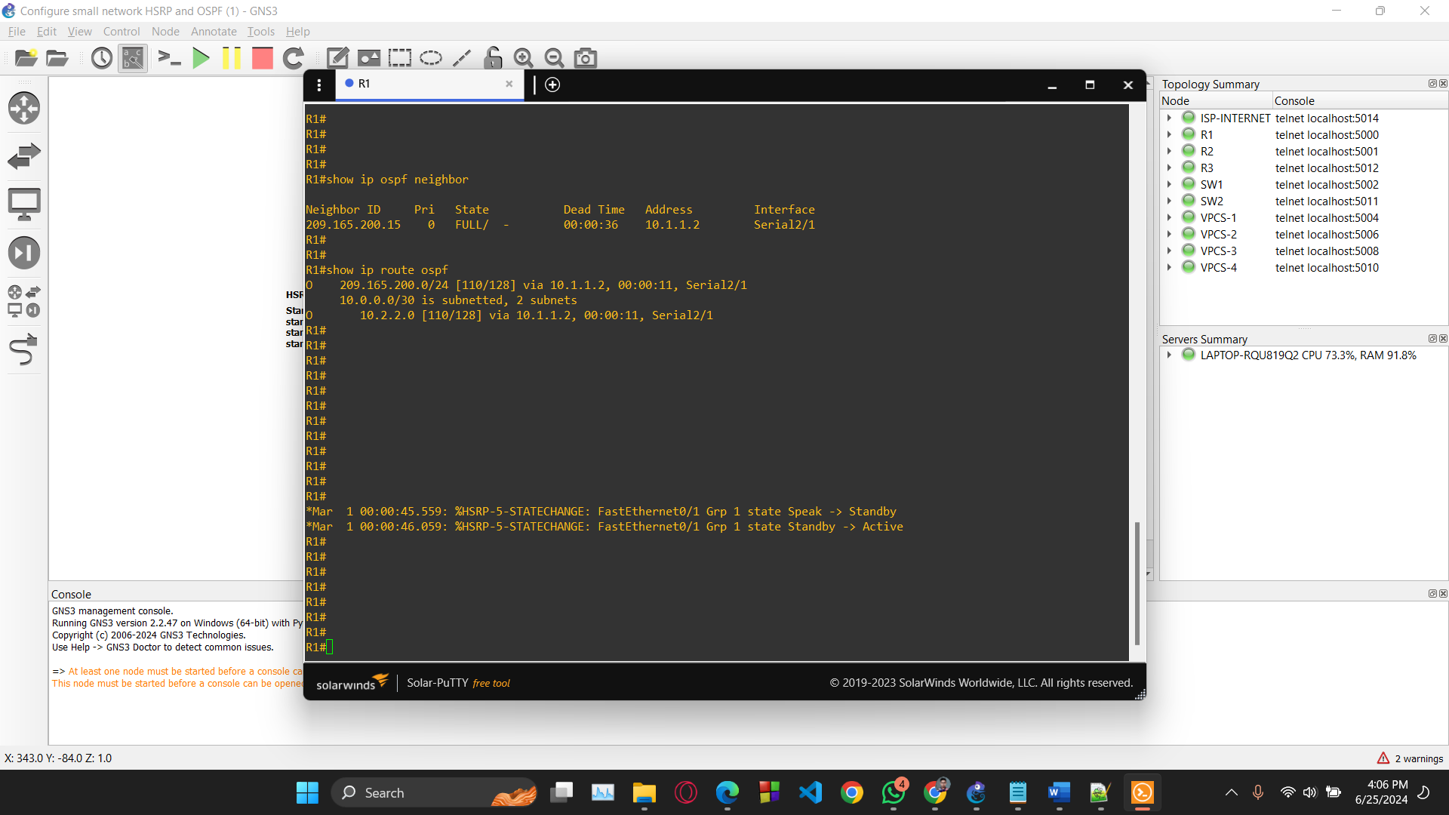
OSPF Configuration of R1

Slide 10
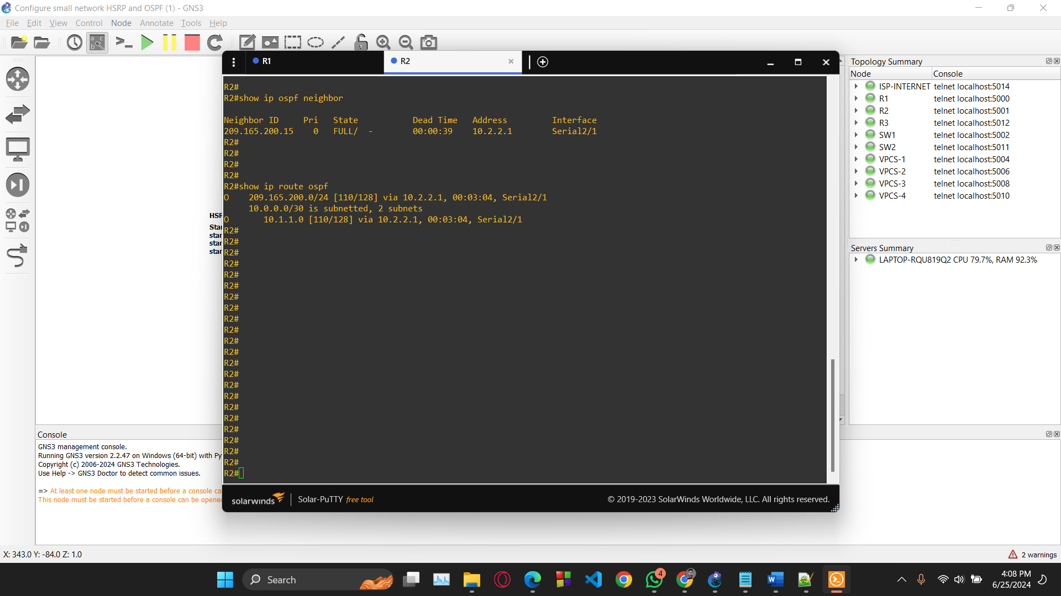
OSPF Configuration of R2

Slide 11
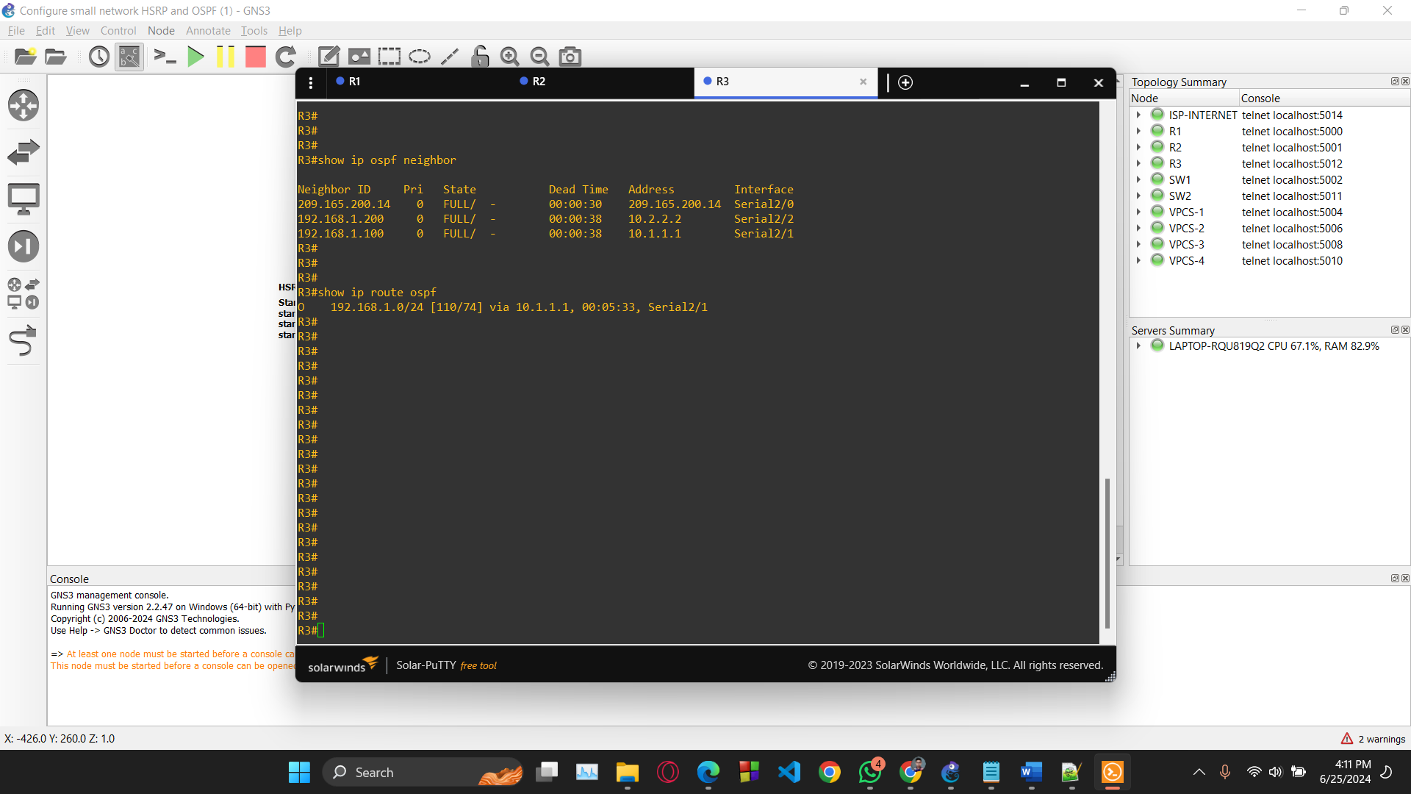
OSPF Configuration of R3

Slide 12
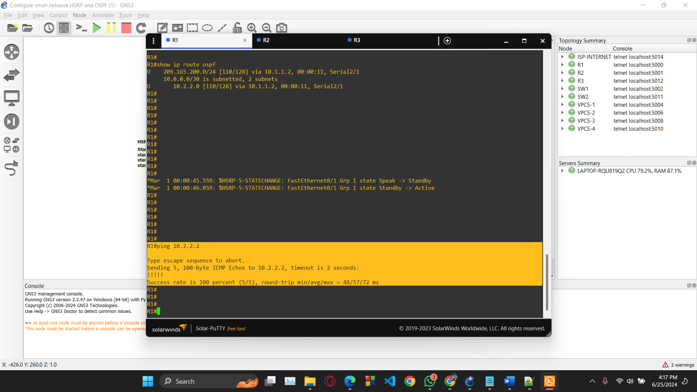
Ping from R1 to R2

Slide 13
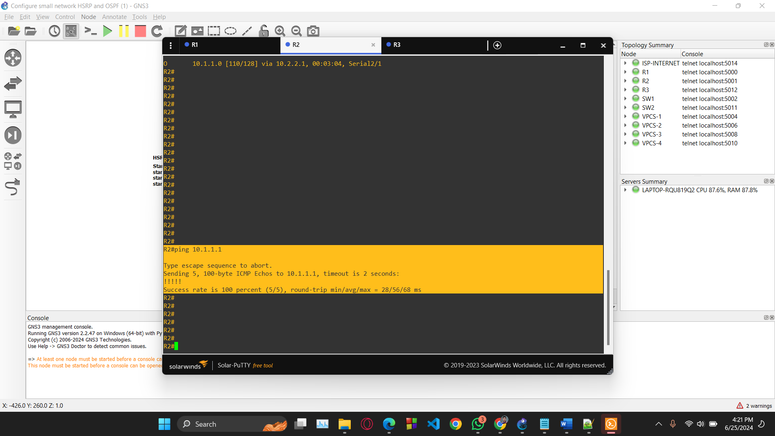
Ping from R2 to r1

Slide 14
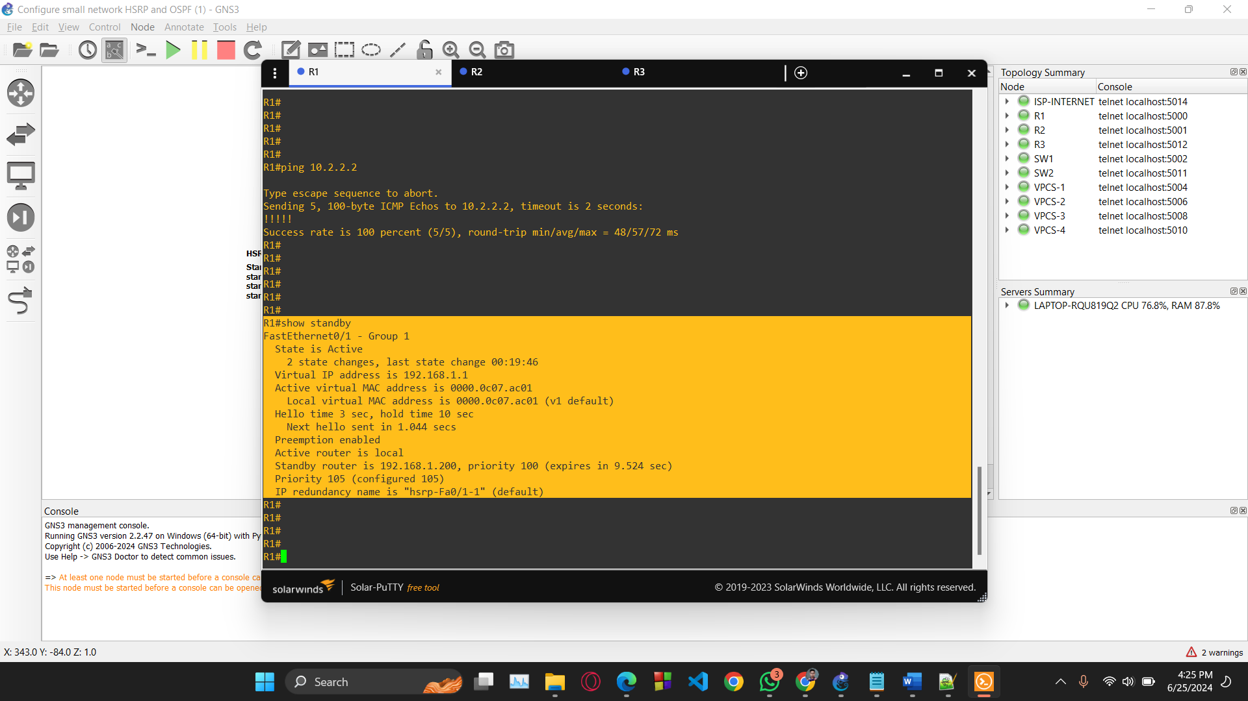
Active State

Slide 15
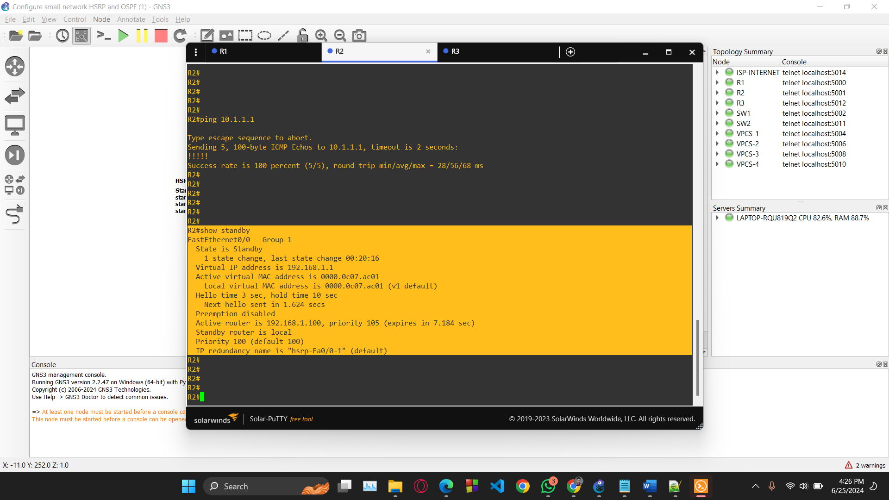
R2 Standby state

Slide 16
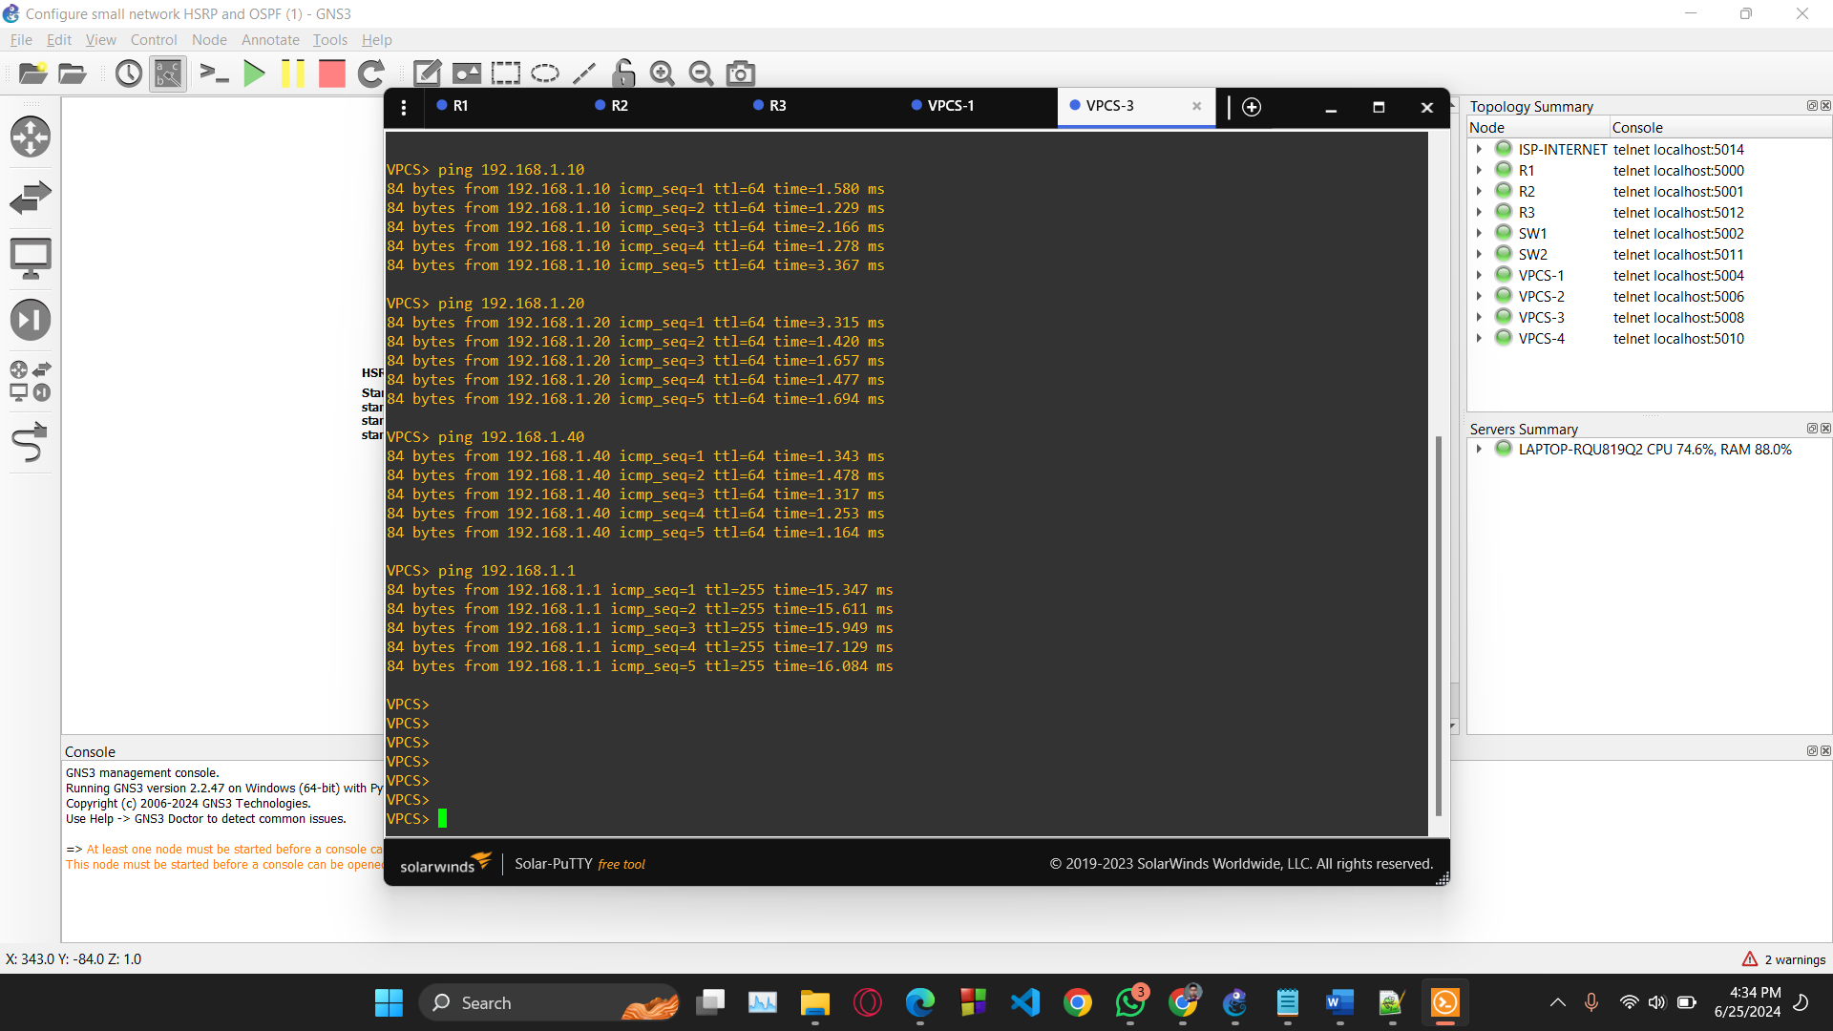
Ping from PC3 to PC1, PC2, PC4, Virtual IP

Slide 17
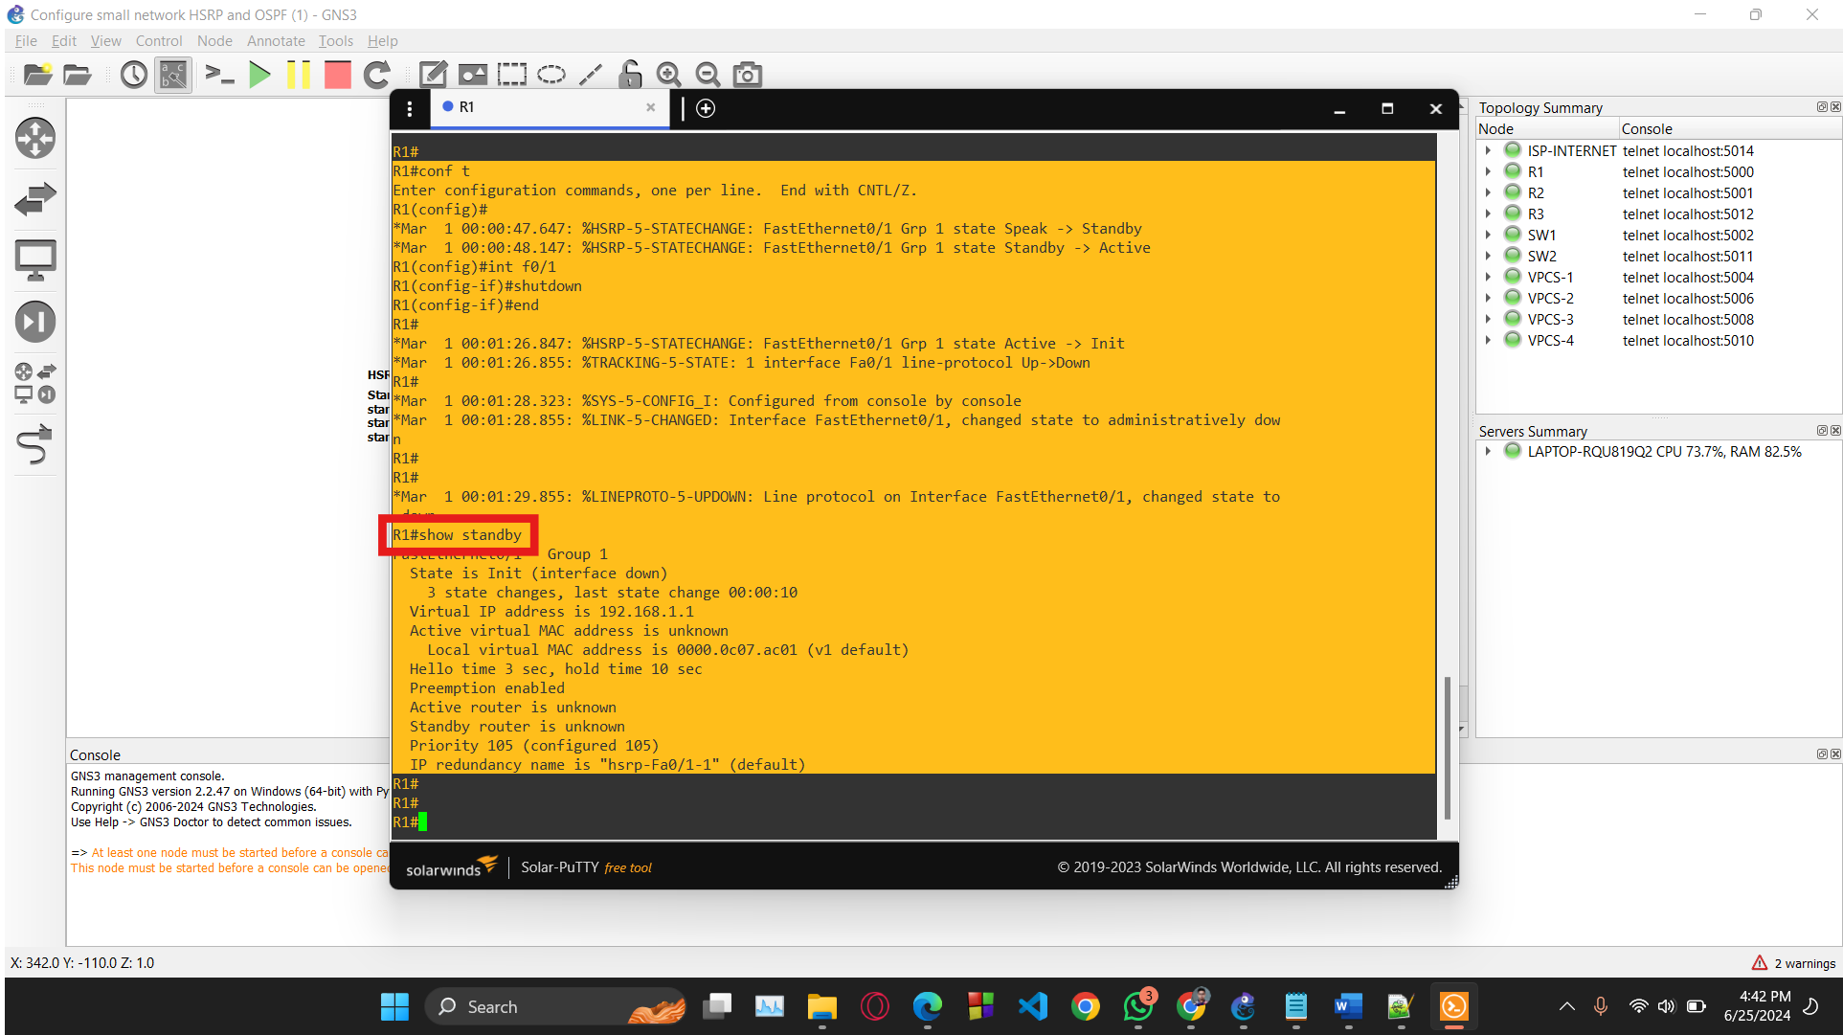
Failover Test: Shutdown r1

Slide 18
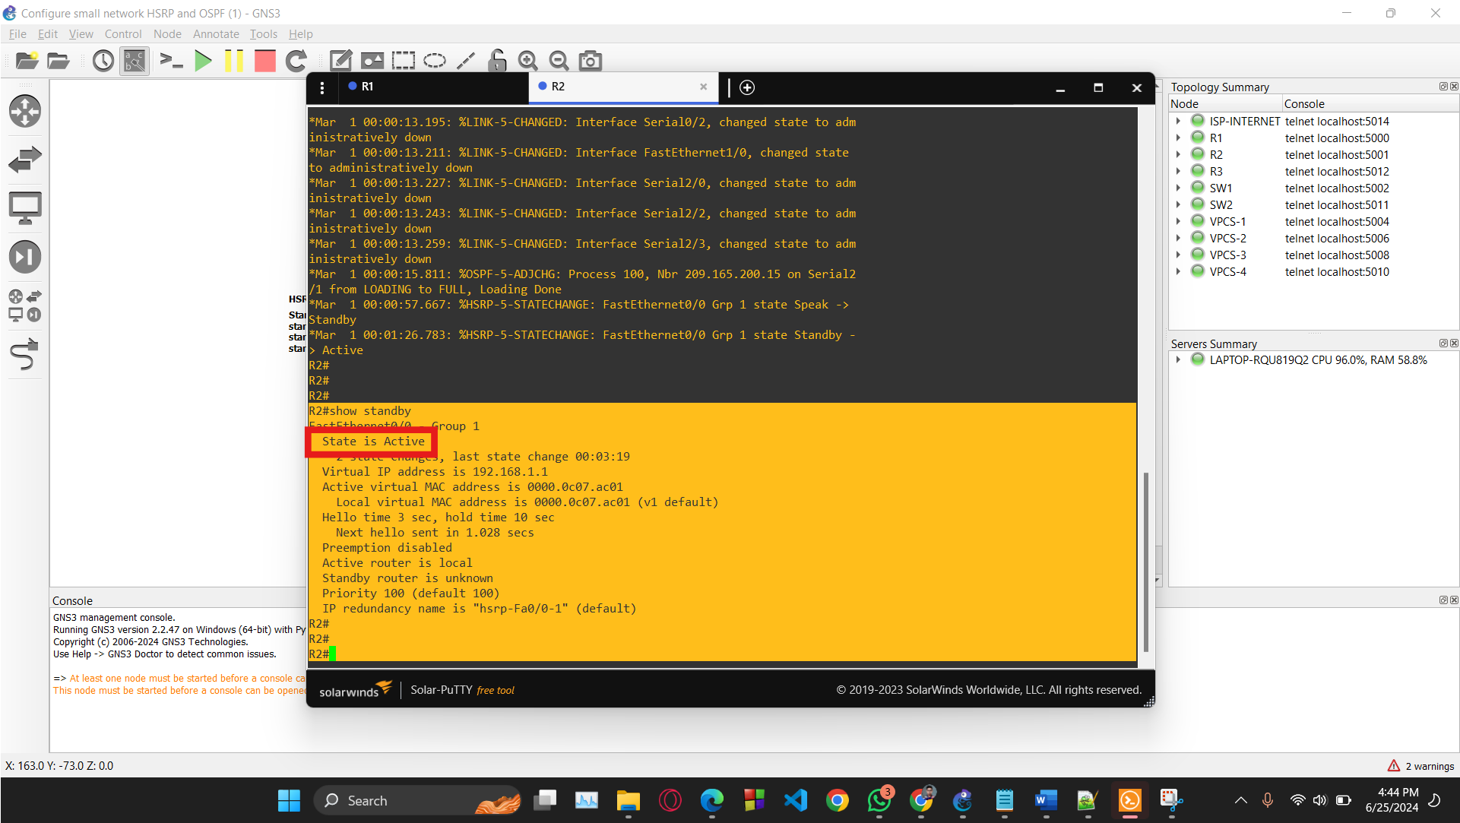
Failover Test: R2 Automatically Activated

Slide 19
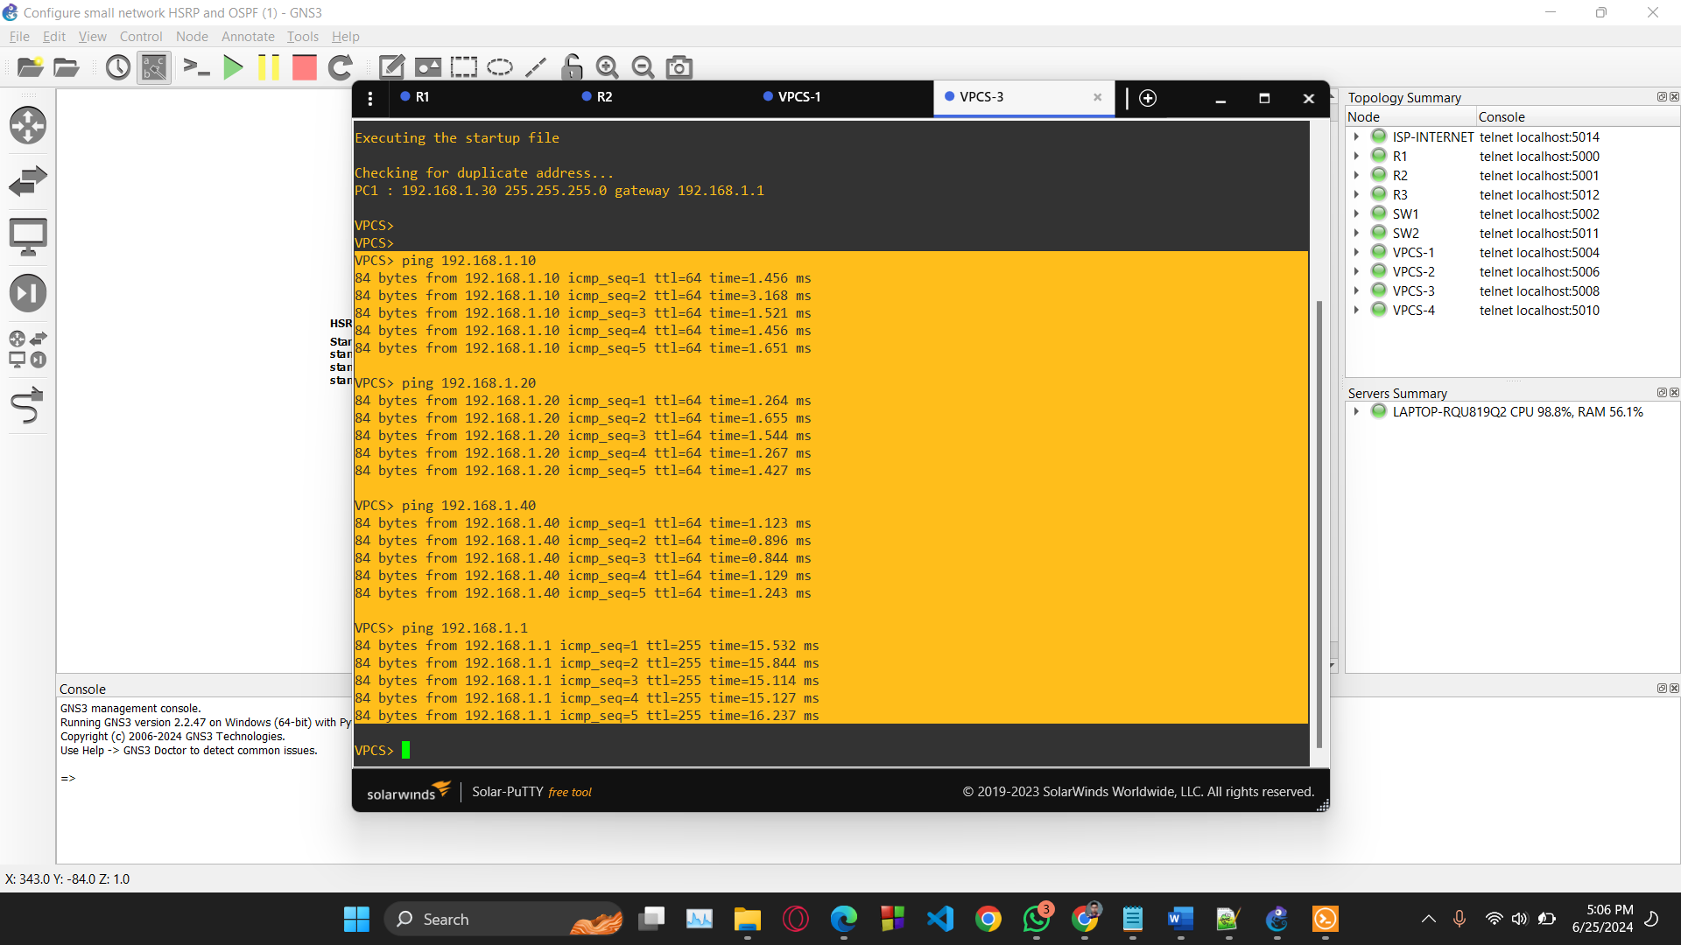
Ping from PC3 to PC1, PC2, PC4, Virtual IP

Slide 20
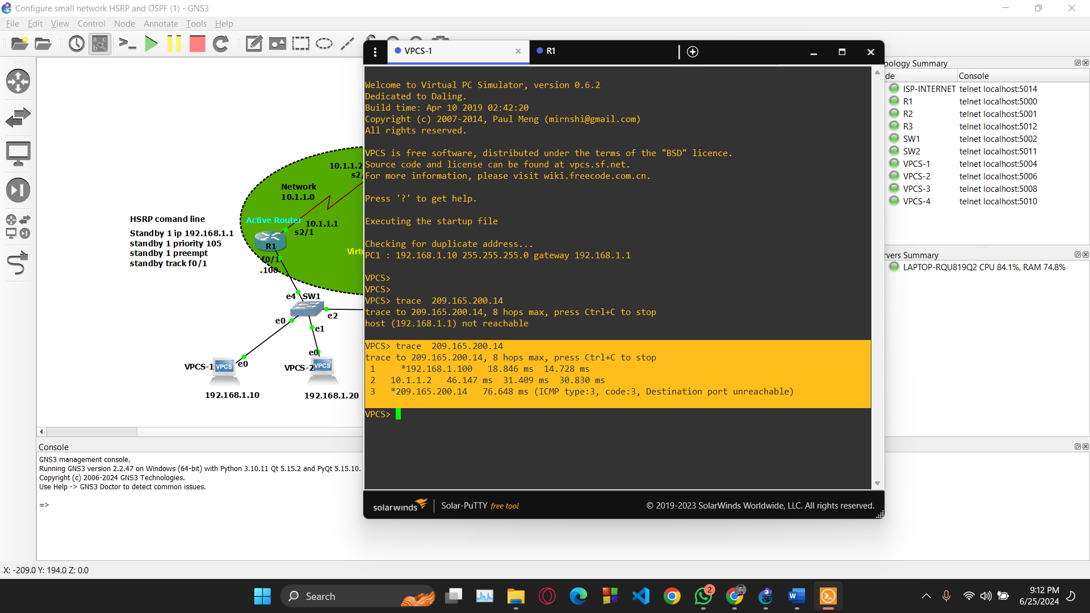
Data Packet Tracing: Represents the packet reach to ISP via Router

Slide 21
Practical Insights
Router Safety Net | Adapting to Changes
Smart Data Paths | Growing Bigger
Teamwork for Reliability | Happy Users
Quick Recovery Focus | Smart Operations

Slide 22
Future Work
Expand Network Scalability: Test HSRP and OSPF in larger, more complex topologies.
Automate Network Management: Integrate IPsec and ACLs for improved network security.
Enhance Security Measures: Deploy scripts for configuration backups and failover tests.
Performance Monitoring and Optimization: Use advanced tools for real-time traffic analysis and optimization.

Slide 23
Conclusion
Our journey towards network optimization continues. We will remain focused on reducing downtime and enhancing scalability to accommodate larger networks. Our commitment will be ongoing improvements underscores our dedication to building a resilient and efficient network capable of thriving in any situation. With a proactive approach to innovation and optimization, we strive to continuously elevate the performance and reliability of our network infrastructure.

Slide 24
References
[1] "How to Configure OSPF in GNS3 - OSPF Routing Configuration Step by Step - OSPF Basic Concepts," Technical Xpress, Available: https://youtu.be/Iib20MF8y-c?si=eKBCga6e_pJDl5_y
[2] "How to configure Hot Standby Router Protocol (HSRP) in #GNS3," VaelTech, Available: https://www.youtube.com/watch?v=TnoOAps8pM0
[3] "Hot Standby Router Protocol (HSRP) - GeeksforGeeks," GeeksforGeeks, Available: https://www.geeksforgeeks.org/hot-standby-router-protocol-hsrp/
[4] "How to Configure OSPF in GNS3 - OSPF Routing Configuration Step by Step - OSPF Basic Concepts," Technical Xpress, Available: https://www.youtube.com/watch?v=Iib20MF8y-c
[5] "HSRP Depth Explanation | All about HSRP Protocol | HSRP Preemption | HSRP Track | HSRP Timer |," PM Networking, Available: https://www.youtube.com/watch?v=EUc2glGjDMs [6] Abdul Majid Soomro, Awad Bin Naeem, Fridous Ayub, Biswaranjan Senapati, Muhammad Imran Ghafoor, & Nimra bari. (2023). Performance Evaluation of Routing Protocol OSPF with GNS3. Journal of Computing & Biomedical Informatics, 5(01), 174–182. Retrieved from: https://jcbi.org/index.php/Main/article/view/166

Slide 25
Meeting Records
No. | Date | Meeting Purpose | Assigned for Next
1. | 16 May, 2024 | Project Selection | Finalization
2. | 17 May, 2024 | Project Finalize | Collect resources from online, study material etc.
3. | 23 May, 2024 | Resource Collection | Start Coding Phase
4. | 10 June, 2024 | Project Initialize | OSPF Implementation
5. | 15 June, 2024 | Check Progress 1 | HSRP Implementation
6. | 21 June, 2024 | Check Progress 2 | Debugging
7. | 24 June, 2024 | Finish Coding Phase | Report Making
8. | 25 June, 2024 | Report Presentation Making | Finish

Slide 26
Thank you so much!

